Slide 1



Churn Analysis
View in Power BI
Last data refresh:
21/05/2023 11:36:26 UTC
Downloaded at:
21/05/2023 11:39:46 UTC

Slide 2
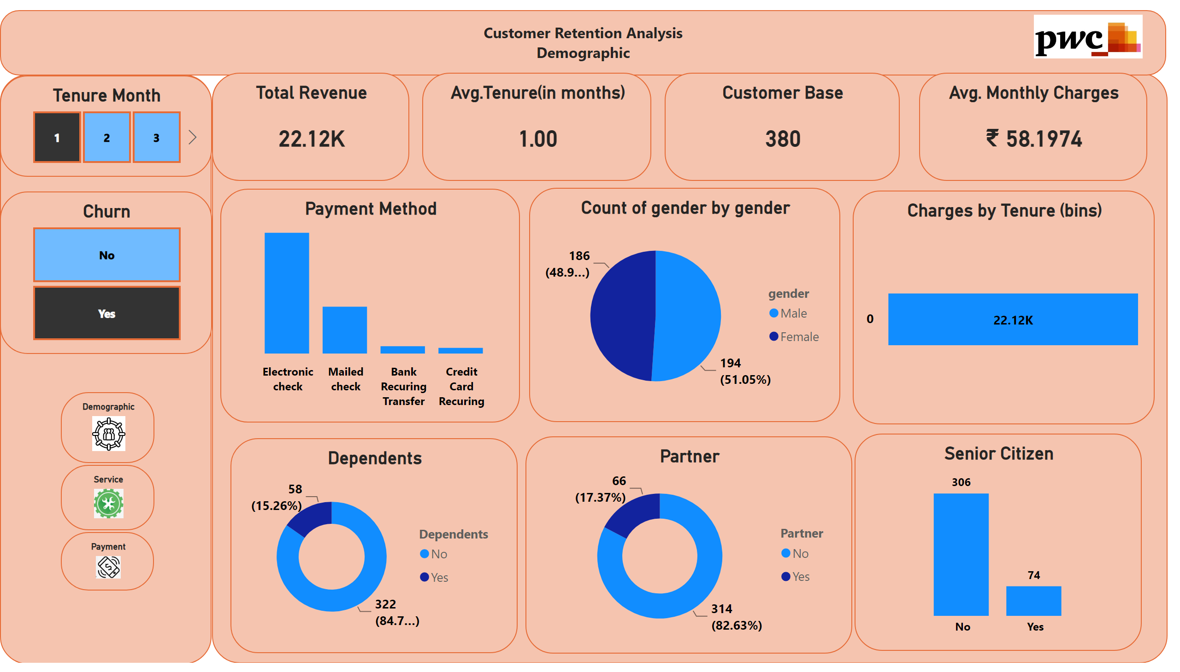
Customer Demo Graphic
Notes:
Payment Method
No alt text provided
pieChart
No alt text provided
Charges by Tenure (bins)
No alt text provided
Total Revenue
No alt text provided
Avg.Tenure(in months)
No alt text provided
Customer Base
No alt text provided
Avg. Monthly Charges
No alt text provided
textbox
No alt text provided
Dependents
No alt text provided
Partner
No alt text provided
Senior Citizen
No alt text provided
Tenure Month
No alt text provided
Payment
No alt text provided
Service
No alt text provided
Demographic
No alt text provided
Churn
No alt text provided
textbox
No alt text provided
textbox
No alt text provided
image
No alt text provided

Slide 3
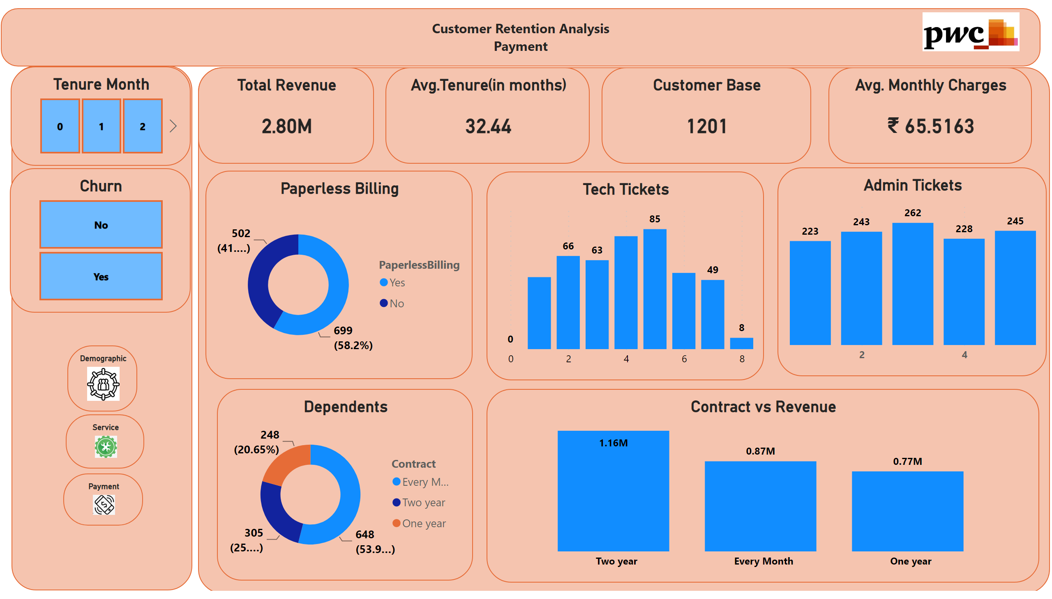
Customer Payment
Notes:
Demographic
No alt text provided
Service
No alt text provided
Payment
No alt text provided
Churn
No alt text provided
textbox
No alt text provided
Admin Tickets
No alt text provided
Paperless Billing
No alt text provided
Total Revenue
No alt text provided
Avg.Tenure(in months)
No alt text provided
Customer Base
No alt text provided
Avg. Monthly Charges
No alt text provided
textbox
No alt text provided
Dependents
No alt text provided
textbox
No alt text provided
image
No alt text provided
Tech Tickets
No alt text provided
Contract vs Revenue
No alt text provided
Tenure Month
No alt text provided

Slide 4
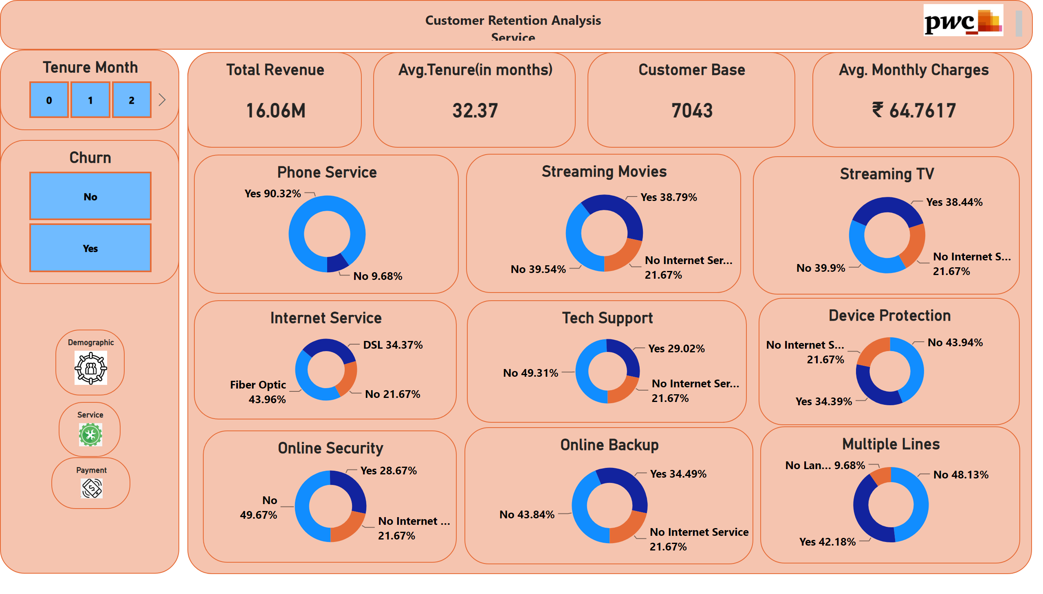
Customer Service
Notes:
Demographic
No alt text provided
Service
No alt text provided
Payment
No alt text provided
Churn
No alt text provided
textbox
No alt text provided
Streaming TV
No alt text provided
Phone Service
No alt text provided
Total Revenue
No alt text provided
Avg.Tenure(in months)
No alt text provided
Customer Base
No alt text provided
Avg. Monthly Charges
No alt text provided
textbox
No alt text provided
Online Backup
No alt text provided
Tech Support
No alt text provided
Online Security
No alt text provided
Internet Service
No alt text provided
textbox
No alt text provided
image
No alt text provided
Streaming Movies
No alt text provided
Multiple Lines
No alt text provided
Dependents
No alt text provided
Dependents
No alt text provided
Dependents
No alt text provided
Device Protection
No alt text provided
Tenure Month
No alt text provided

Slide 5
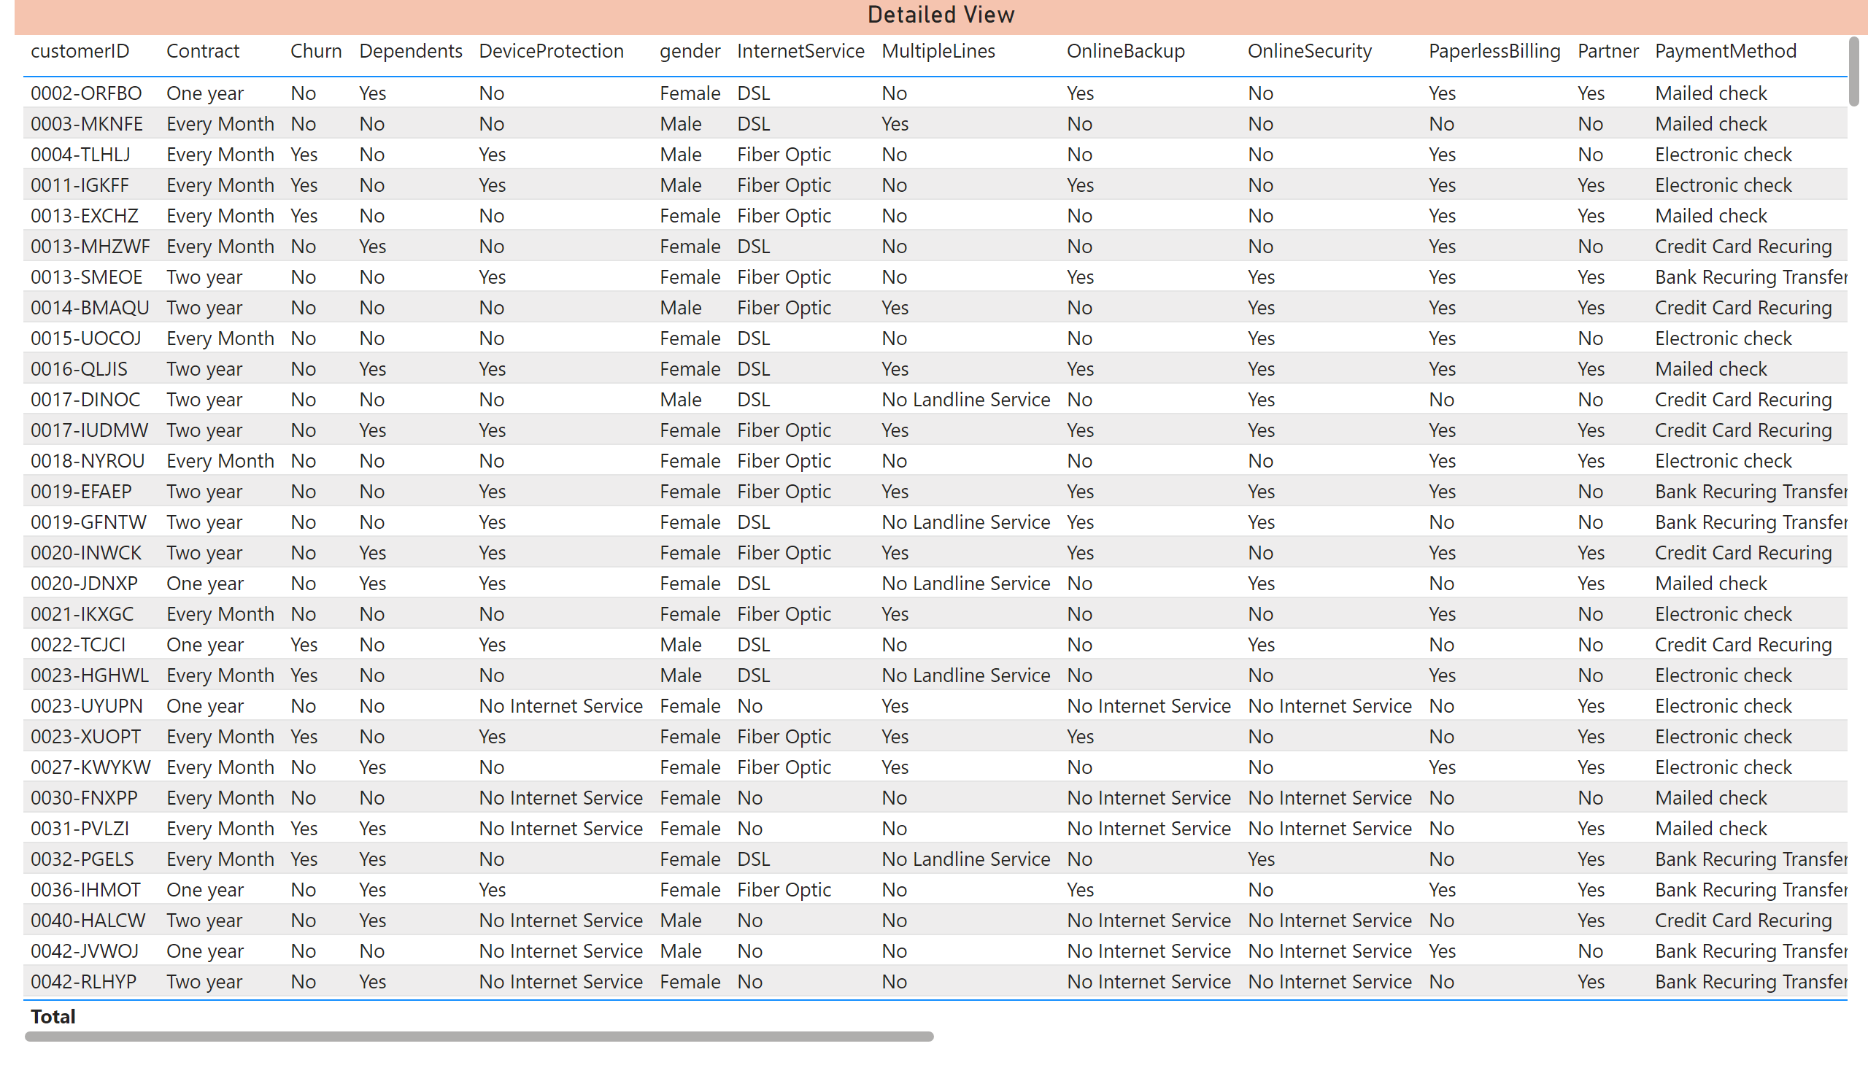
Detailed View
Notes:
Detailed View
No alt text provided

